Slide 1
Control Engineering
Lecture 10

Slide 2
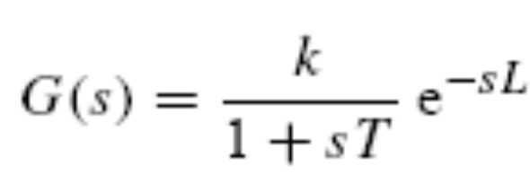
Ziegler–Nichols Tuning Formula
The tuning formula is obtained when the plant model is given by a first-order plus dead time model expressed by

Slide 3
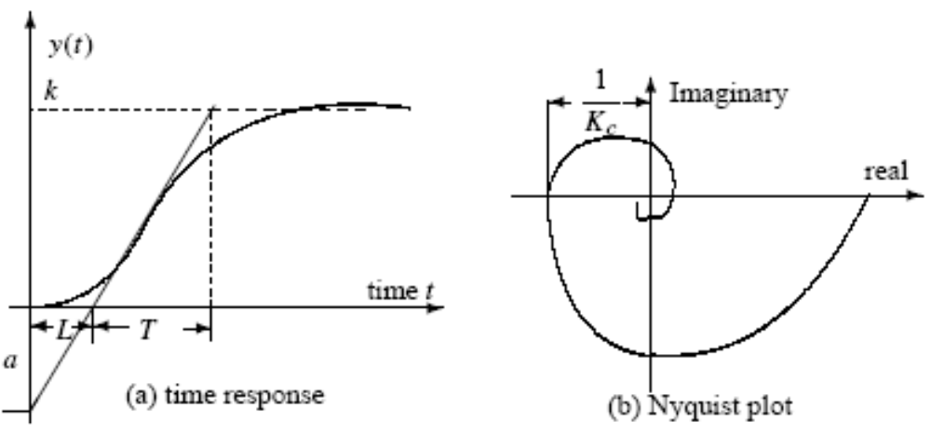
Ziegler–Nichols Tuning Formula

Slide 4
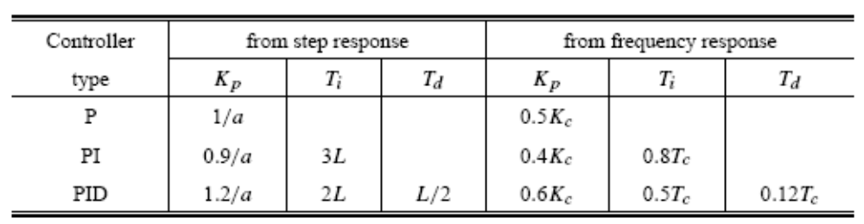
Ziegler–Nichols Tuning Formula

Slide 5
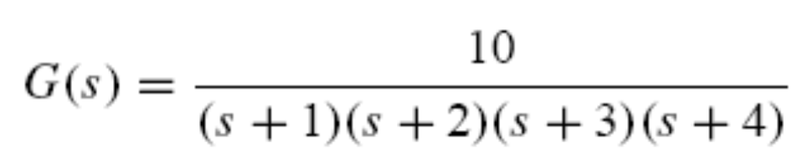
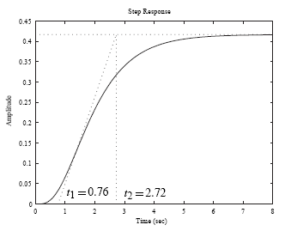
Example
Consider a fourth-order plant:
With the open loop
step response

Slide 6
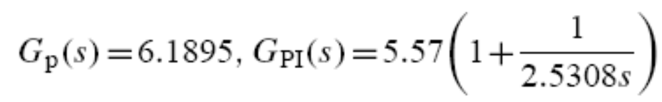
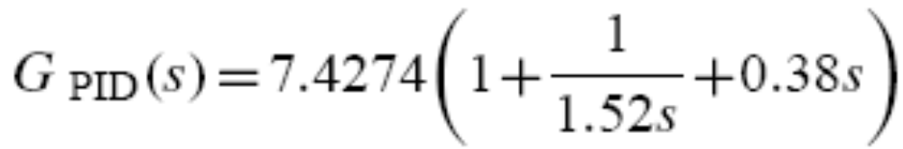
Example
From the step response, the parameters of the approximate model are k = 0.2941, L = 0.76, and T = 2.72 − 0.76 = 1.96, based on which the P, PI, and PID controllers can be designed

Slide 7
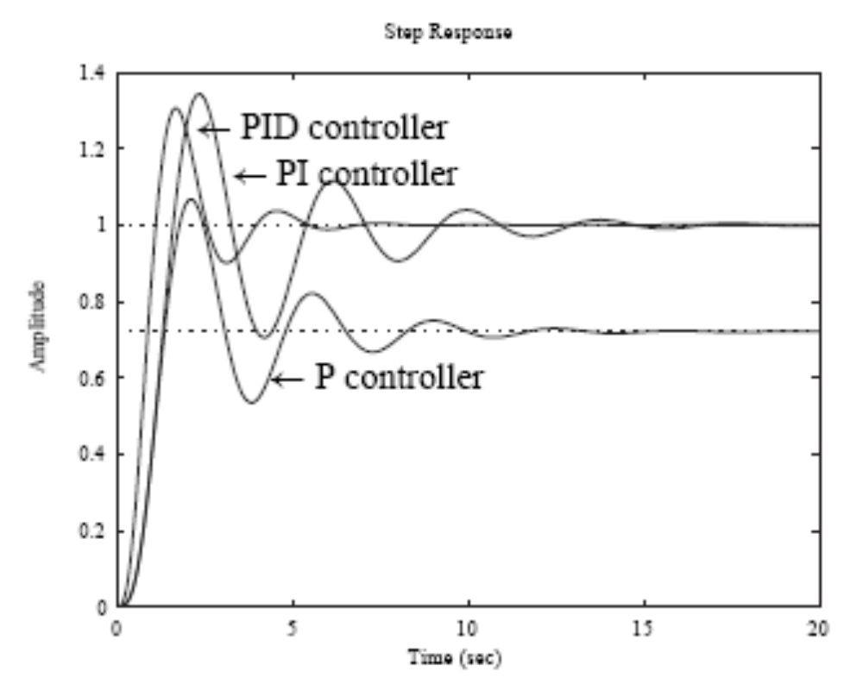
Example
The closed loop step response:

Slide 8
Chien–Hrones–Reswick PID Tuning Algorithm
The Chien–Hrones–Reswick (CHR) method emphasizes the set-point regulation or disturbance rejection. In addition one qualitative specifications on the response speed and overshoot can be accommodated.
Compared with the traditional Ziegler–Nichols tuning formula, the CHR method uses the time constant T of the plant explicitly.

Slide 9
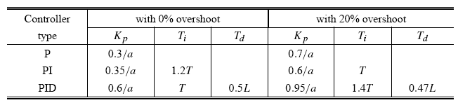
CHR tuning formulae for set-point regulation
The more heavily damped closed-loop response, which ensures, for the ideal plant model, the “quickest response without overshoot” is labeled “with 0% overshoot,” and
the “quickest response with 20% overshoot” is labeled “with 20% overshoot.”

Slide 10
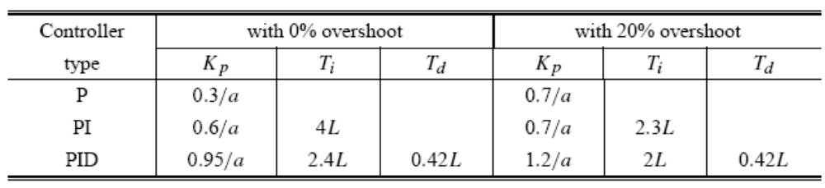
CHR tuning formulae for disturbance rejection

Slide 11
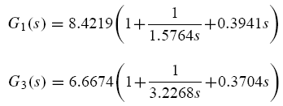
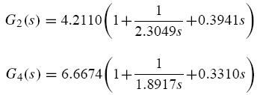
Example
For the same plant as in the previous example, the controllers with the CHR method are:

Slide 12
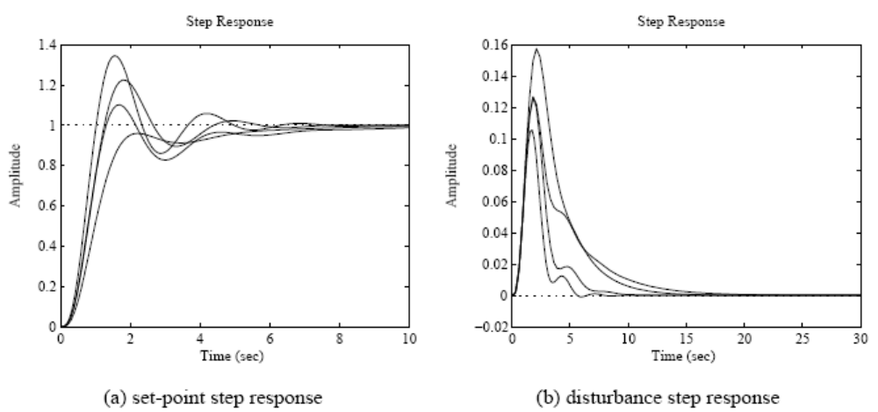
Example
Homework: compare the results with the Ziegler-Nichols results

Slide 13
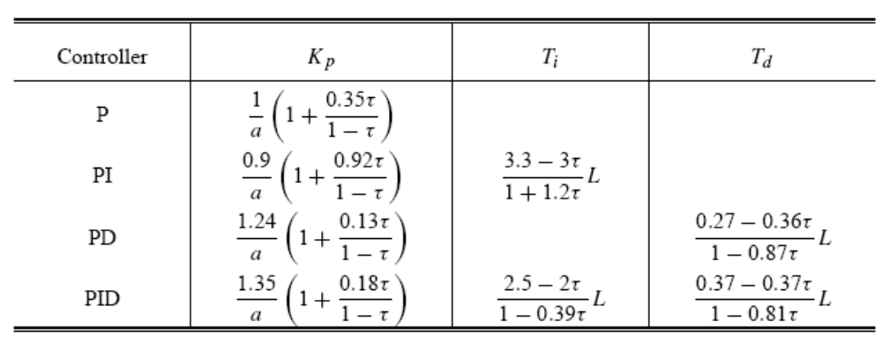
Cohen–Coon Tuning Algorithm
Another Ziegler–Nichols type tuning algorithm is the Cohen–Coon tuning formula where a = kL/T and τ = L/(L+T ).

Slide 14
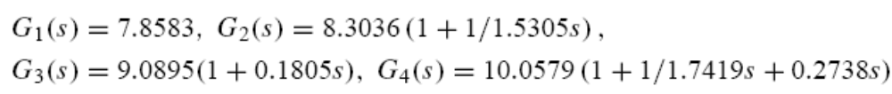
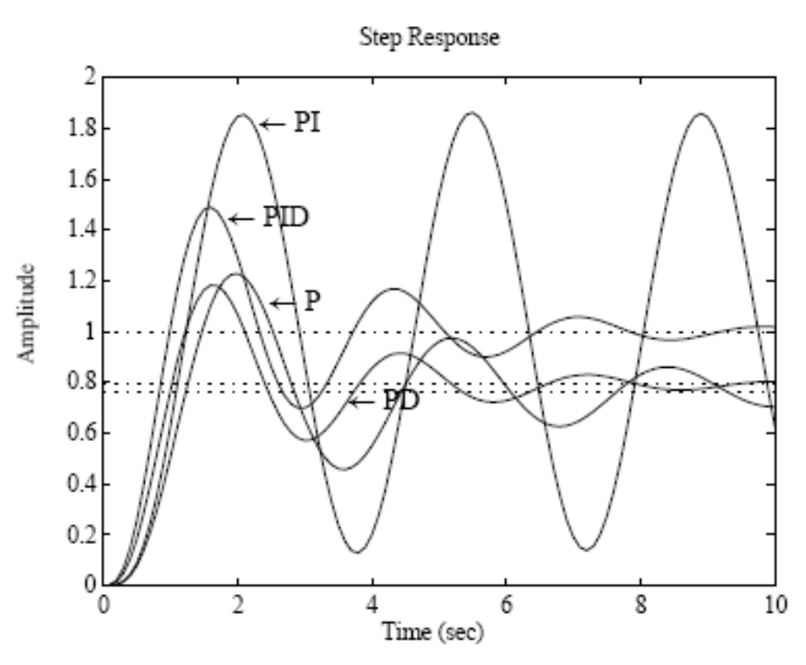
Example
For the same plant

